Slide 1

Simulating the Effect of the Nutrition Fact Label Revision: Added Sugar and the Demand for Ready-to-Eat Breakfast Cereals
Alessandro Bonanno,¹Armen Ghazaryan¹, Andrea Carlson², and Rebecca Cleary¹,
1: Department of Agricutltural and Reosurce Economics
Colorado State University
2: United States Department of Agriculture, Economic Research Service
The Findings and Conclusions in This Preliminary Presentation Have Not Been Formally Disseminated by the U. S. Department of Agriculture and Should Not Be Construed to Represent Any Agency Determination or Policy.
This research was supported in part by the intramural research program of the U.S. Department of Agriculture, Economic Research Service.
The analysis, findings, and conclusions expressed in this paper also should not be attributed to Information Resources, Inc. (IRI).

Slide 2
Another Disclaimer
Preliminary and incomplete – DO NOT CITE
Bonanno, Ghazaryan, Carlson, and Cleary: Simulating the effect of NFL Changes: RTE Cereals Demand
University Of Minnesota, Department of Applied Economics, Minneapolis, MN, 9/19/2018

Slide 3
1. Background (1/7)
On May 20, 2016, the FDA announced a revision of the Nutrition Facts Label for packaged foods
Revisions will include changes to reflect the link between diet and chronic diseases (e.g. obesity, heart disease)
Initial compliance date: July 26, 2018 (one additional year for manufacturers with annual food sales < $10 million).
Revised compliance date: January 1, 2020 (2021 for “small” food manufacturers).
Bonanno, Ghazaryan, Carlson, and Cleary: Simulating the effect of NFL Changes: RTE Cereals Demand
University Of Minnesota, Department of Applied Economics, Minneapolis, MN, 9/19/2018

Slide 4
1. Background (2/7)
Main changes in the Nutrition Facts Label (NFL)
Larger (bolder) type: serving size; larger type: calories
Updated serving size and daily values
NEW: ADDED SUGAR
Change in nutrients required (Micro)
Actual amounts declared (Micro)
New footnotes
Bonanno, Ghazaryan, Carlson, and Cleary: Simulating the effect of NFL Changes: RTE Cereals Demand
University Of Minnesota, Department of Applied Economics, Minneapolis, MN, 9/19/2018

Slide 5
1. Background (3/7)
8th edition of the DGA (2015-2020) : “ Limit calories from added sugars and saturated fats and reduce sodium intake.”
Recommended amounts not to be exceeded
< 10 % cal/day from added sugars → ~ 50 grams or 12.2 tsp
< 10% cal/ day from saturated fats → ~ 22 grams or 3/4 OZ
< 2,300 mg / day of sodium (1/12 OZ)
American Hearth Association Added Sugar limits:
Men: 150 calories / 36 grams / 9 tsp ;
Women: 100 calories / 25 grams / 6 tsp
Note: 12 fluid OZ Regular Coke ~ 39 grams of added sugar
Bonanno, Ghazaryan, Carlson, and Cleary: Simulating the effect of NFL Changes: RTE Cereals Demand
University Of Minnesota, Department of Applied Economics, Minneapolis, MN, 9/19/2018

Slide 6
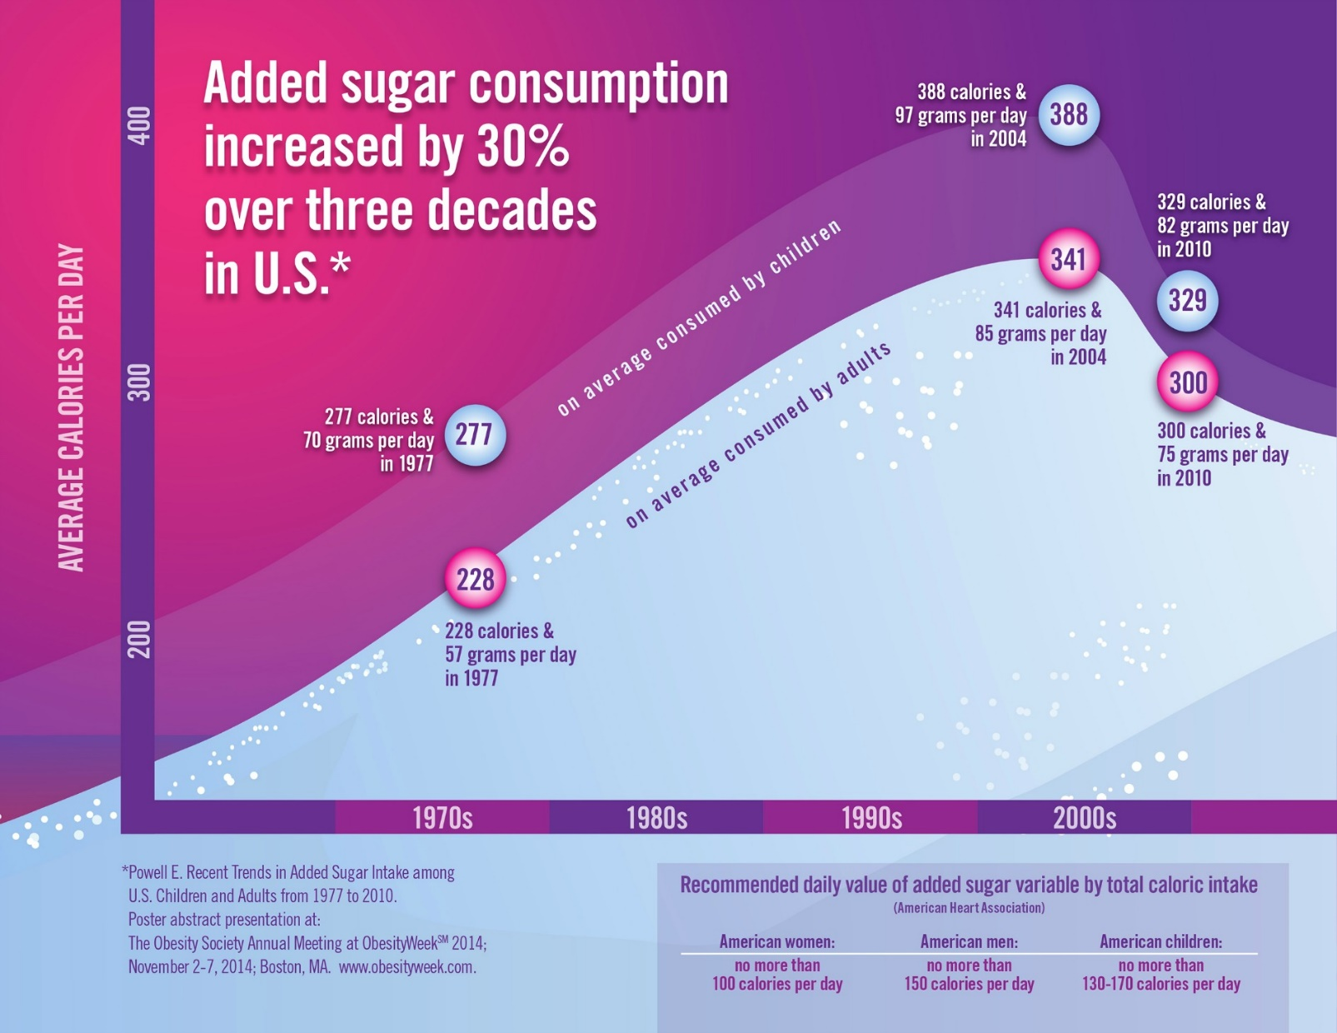
1. Background (4/7)
Source Mollie Turner, The Obesity Society: http://www.obesity.org/news/press-releases/us-adult
Bonanno, Ghazaryan, Carlson, and Cleary: Simulating the effect of NFL Changes: RTE Cereals Demand
University Of Minnesota, Department of Applied Economics, Minneapolis, MN, 9/19/2018

Slide 7
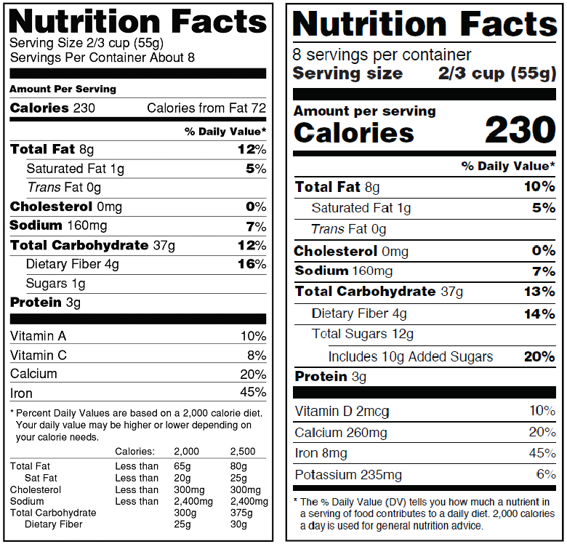
1. Background (5/7)
Source:https://www.fda.gov/Food/GuidanceRegulation/GuidanceDocumentsRegulatoryInformation/LabelingNutrition/ucm385663.htm
Bonanno, Ghazaryan, Carlson, and Cleary: Simulating the effect of NFL Changes: RTE Cereals Demand
University Of Minnesota, Department of Applied Economics, Minneapolis, MN, 9/19/2018

Slide 8
1. Background (6/7)
The FDA definition of added sugars includes all sugars that are either added during the processing of foods, or are packaged as such:
Sugars (free, mono- and disaccharides);
Sugars from syrups and honey;
Sugars from concentrated fruit or vegetable juices in excess of what would be expected from the same volume of 100 percent fruit or vegetable juice of the same type.
Excluded: fruit or vegetable juice concentrated from 100% fruit juice sold to consumers as well as some sugars found in fruit and vegetable juices, jellies, jams, preserves, and fruit spreads.
FDA currently reconsidering “added sugar” labels for honey and maple syrup.
Bonanno, Ghazaryan, Carlson, and Cleary: Simulating the effect of NFL Changes: RTE Cereals Demand
University Of Minnesota, Department of Applied Economics, Minneapolis, MN, 9/19/2018

Slide 9
1. Background (7/7)
Existing Literature on labeling (and use of NFL) is plentiful, but only limited research exists on NFL revision / added sugar label
Laquatra et al (2015): providing information on “added sugar” content can mislead consumers; such misperception can influence purchase intent
Kandhapur et al (2017): consumer understanding of different display of added sugar info on NFL → Providing high/medium/low text, %DV, or combination, leads to better understanding
Grebitus and Davis (2017): consumers pay more attention to the modified NFL than the current one for healthier foods, whereas they pay less attention to the new NFP compared to the current, for less healthy items.
Bonanno, Ghazaryan, Carlson, and Cleary: Simulating the effect of NFL Changes: RTE Cereals Demand
University Of Minnesota, Department of Applied Economics, Minneapolis, MN, 9/19/2018

Slide 10
2. Research Question (1/4)
How will the “added sugar” information in the new NFL affect the demand for Ready-to-Eat Breakfast Cereals?
Use unique / novel dataset and method
IRI (PoS) matched with “Linkages”: data enhancement for IRI data developed by ERS - it allows us to import the added sugar data from USDA nutrition databases (more details later)
Fosgerau, de Palma, and Monardo (2018) Cross-Nested Generalized Nested Entropy (CN-GNE) demand model
Bonanno, Ghazaryan, Carlson, and Cleary: Simulating the effect of NFL Changes: RTE Cereals Demand
University Of Minnesota, Department of Applied Economics, Minneapolis, MN, 9/19/2018

Slide 11
2. Research Question: why RTEBC? (2/4)
Cereals’ nutritional quality has generally improved since 2001 (Thomas et al. 2013: Wang, Rojas, and Bauner, 2015)
Harris et al (2012) evaluated the Nutrition Profiling Index (NPI) of RTE cereals in the US (based on calories, fiber, sugar, sodium, etc.) from 2006 to 2012.
Reformulations: ↓sugar and sodium; ↑ fiber
Nutritional quality of cereal brands improved by 14% for children’s cereals, 12 % for family cereals, and 5% for adult cereals
Bonanno, Ghazaryan, Carlson, and Cleary: Simulating the effect of NFL Changes: RTE Cereals Demand
University Of Minnesota, Department of Applied Economics, Minneapolis, MN, 9/19/2018

Slide 12
2. Research Question: why RTEBC? (3/4)
Source:
Thomas et al 2013.
Bonanno, Ghazaryan, Carlson, and Cleary: Simulating the effect of NFL Changes: RTE Cereals Demand
University Of Minnesota, Department of Applied Economics, Minneapolis, MN, 9/19/2018

Slide 13
2. Research Question: why RTEBC? (4/4)
Not all consumers make the “healthiest” RTE cereal choices:
Consumers with lower income tend to have a stronger preference for sugary cereals (e.g. Nevo 2001; Chidmi and Lopez 2007)
Binkley and Golub (2011): education and income are positively linked to more healthful RTE cereals choices (controlling for prices)
Information (not pricing intervention) may lead to healthier cereal purchases
Rahkovsky et al (2013): using a Guiding Star Program™ (GSP) tag may affect the demand of more nutritious RTE cereals at the expense of less nutritious ones.
Lin et al. (2017): a tax / subsidy scheme aimed to increase the consumption of high-nutrition RTE cereals may have limited effect on overall REBC demand and even have unintended consequences (i.e. increase overall breakfast caloric intake).
Bonanno, Ghazaryan, Carlson, and Cleary: Simulating the effect of NFL Changes: RTE Cereals Demand
University Of Minnesota, Department of Applied Economics, Minneapolis, MN, 9/19/2018

Slide 14
3. The Modelling Approach
1) Demand Side: CN-GNE;
Demand parameters
2) Supply Side; SR Nash Bertrand
Estimate PCM and Marginal costs
Bonanno, Ghazaryan, Carlson, and Cleary: Simulating the effect of NFL Changes: RTE Cereals Demand
University Of Minnesota, Department of Applied Economics, Minneapolis, MN, 9/19/2018

Slide 15
3. The Modelling Approach
1) Demand Side: CN-GNE;
Demand parameters
2) Supply Side; SR Nash Bertrand
Estimate PCM and Marginal costs
3) Use estimates + Linkages data
to simulate preference parameters
for added sugar
4) Simulate changes in Demand
(market shares) once added sugar
content is known to consumers
Bonanno, Ghazaryan, Carlson, and Cleary: Simulating the effect of NFL Changes: RTE Cereals Demand
University Of Minnesota, Department of Applied Economics, Minneapolis, MN, 9/19/2018

Slide 16
3. The Modelling Approach
1) Demand Side: CN-GNE;
Demand parameters
2) Supply Side; SR Nash Bertrand
Estimate PCM and Marginal costs
3) Use estimates + Linkages data
to simulate preference parameters
for added sugar
5) Use modified market shares
And marginal costs to predict new
Equilibrium price
4) Simulate changes in Demand
(market shares) once added sugar
content is known to consumers
6) Updated market shares, calculate
total amounts of sugar purchased
and post-price adj. changes in sugar
Bonanno, Ghazaryan, Carlson, and Cleary: Simulating the effect of NFL Changes: RTE Cereals Demand
University Of Minnesota, Department of Applied Economics, Minneapolis, MN, 9/19/2018

Slide 17
3. The Modelling Approach: Demand (1/6)
Fosgerau, de Palma, and Monardo (2018) Cross-Nested Generalized Nested Entropy (CN-GNE) demand model
FdPM: framework that reconciles Additive Random Utility (ARUM) models with Representative Consumer Models (RCM) – extension of Anderson et al. (1988) and Verboven (1996)
Any ARUM can be represented using a General Entropy Model (GEM)
GEM class is strictly larger than ARUM; GEM allow for complementarity –not possible in demand models obtained from ARUM
GEM easier empirical tractability than “traditional” discrete choice models – (e.g. Berry, 1994; BLP 1995; Nevo 2000; 2001; Dube et al, 2010)
Bonanno, Ghazaryan, Carlson, and Cleary: Simulating the effect of NFL Changes: RTE Cereals Demand
University Of Minnesota, Department of Applied Economics, Minneapolis, MN, 9/19/2018

Slide 18
3. The Modelling Approach: Demand (2/6)
Consider the following indirect utility maximization problem (over J+1 goods; one good serving as the numeraire)
Bonanno, Ghazaryan, Carlson, and Cleary: Simulating the effect of NFL Changes: RTE Cereals Demand
University Of Minnesota, Department of Applied Economics, Minneapolis, MN, 9/19/2018

Slide 19
3. The Modelling Approach: Demand (2/6)
Consider the following indirect utility maximization problem (over J+1 goods; one good serving as the numeraire)
FdPM show that there exist a vector of non-zero GE demands
NOTE: we use different notation than FdPM to (ultimately) highlight similarities with ARUM Logit models!!!
Bonanno, Ghazaryan, Carlson, and Cleary: Simulating the effect of NFL Changes: RTE Cereals Demand
University Of Minnesota, Department of Applied Economics, Minneapolis, MN, 9/19/2018

Slide 20
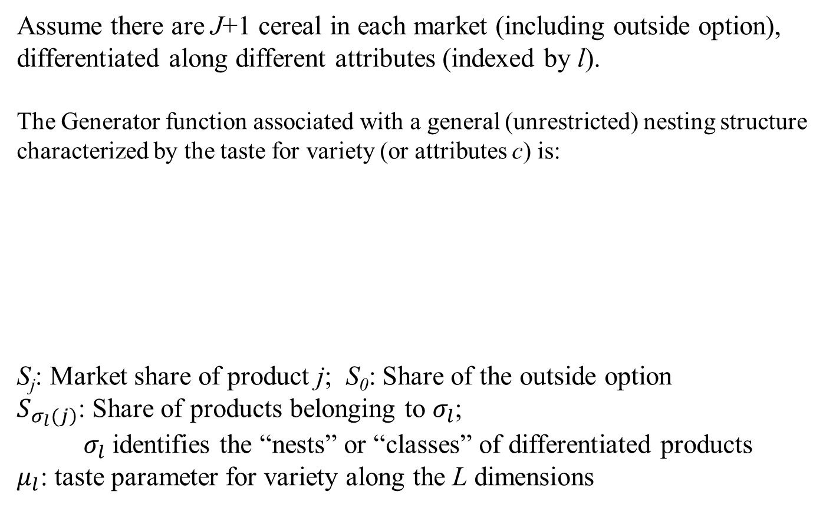
3. The Modelling Approach: Demand (3/6)
Assume there are J+1 cereal in each market (including outside option), differentiated along different attributes (indexed by l).
The Generator function associated with a general (unrestricted) nesting structure characterized by the taste for variety (or attributes c) is:
S_{j}: Market share of product j; S₀: Share of the outside option
$S_{\left.σ_{l}(j\right)}$: Share of products belonging to $σ_{l}$;
$σ_{l}$ identifies the “nests” or “classes” of differentiated products
$μ_{l}$: taste parameter for variety along the L dimensions
Bonanno, Ghazaryan, Carlson, and Cleary: Simulating the effect of NFL Changes: RTE Cereals Demand
University Of Minnesota, Department of Applied Economics, Minneapolis, MN, 9/19/2018

Slide 21
3. The Modelling Approach: Demand (4/6)
Taking logs on both sides and rearranging one has
Which can be estimated using standard econometric techniques
Cross Nested-Generalized Nested Entropy (CN-GNE): similar to Bresnahan et al. (1997) product differentiation logit model
For some ranges of μ_{l} and d FdPM show that the CN-GNE can lead to negative cross price parameters
→ the smaller the μ_{l} the “farther” (a la Pinkse and Slade 2004) the ` products attribute l will be (and more likely to be complements)
Bonanno, Ghazaryan, Carlson, and Cleary: Simulating the effect of NFL Changes: RTE Cereals Demand
University Of Minnesota, Department of Applied Economics, Minneapolis, MN, 9/19/2018

Slide 22
3. The Modelling Approach: Demand (5/6)
How does it differ from a Nested Logit?
FdPM (2018) application of CN-GNE to cereal demand in Chicago
Bonanno, Ghazaryan, Carlson, and Cleary: Simulating the effect of NFL Changes: RTE Cereals Demand
University Of Minnesota, Department of Applied Economics, Minneapolis, MN, 9/19/2018

Slide 23
3. The Modelling Approach: Demand (6/6)
Elasticities
One can use actual or predicted shares;
Predicted shares solve the non-linear system of equation
Bonanno, Ghazaryan, Carlson, and Cleary: Simulating the effect of NFL Changes: RTE Cereals Demand
University Of Minnesota, Department of Applied Economics, Minneapolis, MN, 9/19/2018

Slide 24
3. The Modelling Approach: Supply
Each cereal producer solves
Assume Nash-Bertrand (NB); the FOCs lead to:
Use demand estimates and prices to solve for the marginal cost
Bonanno, Ghazaryan, Carlson, and Cleary: Simulating the effect of NFL Changes: RTE Cereals Demand
University Of Minnesota, Department of Applied Economics, Minneapolis, MN, 9/19/2018

Slide 25
3. The Modelling Approach: Simulation (1/4)
Specification 1: preference for sugar same for consumers choosing NHFCS cereals
Amount of sugars
(g/ OZ) from NFL
Indicator variable for products
with FOP “No HFCS” label
Specification 2: preference for sugar is different for those choosing NHFCS cereals
Parameter capturing difference in preference for sugar
For consumers choosing HFCS free cereals
Bonanno, Ghazaryan, Carlson, and Cleary: Simulating the effect of NFL Changes: RTE Cereals Demand
University Of Minnesota, Department of Applied Economics, Minneapolis, MN, 9/19/2018

Slide 26
3. The Modelling Approach: Simulation (2/4)
Post NFL changes added sugar content revealed to consumer; for specification 1:
ASug “added sugar”;
λ and γ taste parameters for Non Added Sugar and Added Sugar
(consumers DO NOT see Non Added Sugar but can compare Sug vs ASug)
If no added sugar (ASug =0) NHF=1;
Substituting +
Rearranging
Similar (slightly more complex) expressions for demand specification 2
Bonanno, Ghazaryan, Carlson, and Cleary: Simulating the effect of NFL Changes: RTE Cereals Demand
University Of Minnesota, Department of Applied Economics, Minneapolis, MN, 9/19/2018

Slide 27
3. The Modelling Approach: Simulation (3/4)
Use λ and γ to calculate simulated post NFP changes shares vector S’
Replace and obtain a new vector d^{New}
Find S^{New} solving
3) Calculate post-NFL change variation in total amounts of sugar (and added sugar) purchased
Bonanno, Ghazaryan, Carlson, and Cleary: Simulating the effect of NFL Changes: RTE Cereals Demand
University Of Minnesota, Department of Applied Economics, Minneapolis, MN, 9/19/2018

Slide 28
3. The Modelling Approach: Simulation (4/4)
Use the simulated shares S^{New} and NB marginal cost to obtain the
new equilibrium price and shares solving simultaneously (for each j)
Where
Update the changes in sugar purchased
Bonanno, Ghazaryan, Carlson, and Cleary: Simulating the effect of NFL Changes: RTE Cereals Demand
University Of Minnesota, Department of Applied Economics, Minneapolis, MN, 9/19/2018

Slide 29
4. Data and Estimation - Linkages (1/4)
FNDDS: Food and Nutrient Database for Dietary Studies
FNDDS provides nutrient values for foods and beverages reported in the dietary intake component of NHANES
Food Patterns Equivalents Database and Food Pattern Ingredient Database (FPED/FPID) converts products in the FNDDS to 37 USDA Food Patterns components. FPED includes
1)Food Patterns Equivalents Ingredient Database (FPID): 37 USDA Food Patterns components per 100 grams of unique ingredients in the FNDDS
2) listings of gram weights for one cup equivalents of fruits, vegetables, dairy, and legumes used in the FPED
Linkages uses Ensemble Codes (ECs) to indicate Standard Reference or FNDDS codes used to find the best possible match between a UPC and a product whose nutrition information is in the FPED/FPID datasets
Bonanno, Ghazaryan, Carlson, and Cleary: Simulating the effect of NFL Changes: RTE Cereals Demand
University Of Minnesota, Department of Applied Economics, Minneapolis, MN, 9/19/2018

Slide 30
4. Data and Estimation – Sample (2/4)
State-level weekly PoS sales data (2013); aggregate store-level data (no RMAs) - REBC sales in grocery stores only
1308 UPCs of RTEBC matched with Linkages.
Information on “child”, “adult”, and “family” styles matched for 528 UPCs from Harris et al (2012); styles of other UPCs from probit predictions.
“Product” aggregation based on the Ensemble Codes
Bonanno, Ghazaryan, Carlson, and Cleary: Simulating the effect of NFL Changes: RTE Cereals Demand
University Of Minnesota, Department of Applied Economics, Minneapolis, MN, 9/19/2018

Slide 31
4. Data and Estimation – Sample (2/4)
State-level weekly PoS sales data (2013); aggregate store-level data (no RMAs) - REBC sales in grocery stores only
1308 UPCs of RTEBC matched with Linkages.
Information on “child”, “adult”, and “family” styles matched for 528 UPCs from Harris et al (2012); styles of other UPCs from probit predictions.
“Product” aggregation based on the Ensemble Codes
Total of 357 Product aggregates → 93 products maintained in the dataset → lower 20% of sales in volume ….
We use “Style of Cereals” and Brands as differentiation space.
 |  | Brand
Style |  | 1 | 2 | 3 | 4 | 5 | 6 | 7
Child |  | 8 |  | 10 |  | 6 | 4 | 1
Adult |  | 6 | 7 | 1 | 9 | 11 | 10 | 4
Family |  |  |  | 1 | 1 | 5 | 9
Bonanno, Ghazaryan, Carlson, and Cleary: Simulating the effect of NFL Changes: RTE Cereals Demand
University Of Minnesota, Department of Applied Economics, Minneapolis, MN, 9/19/2018

Slide 32
4. Data and Estimation: Ident. Strategy (4/4)
Price IVs
Price for grains - Monthly National Grain Index Price (NASS) in 2013 (Source USDA – NASS) * grain content (Linkages) OZ of edible weight
Diesel Price - Weekly U.S. No 2 Diesel Retail Prices by regions. $/gal (Source: U.S. Energy Information Administration)
Electricity Price - Average monthly electricity (commercial) prices by state. Cents / KWH. (Source: U.S. Energy Information Administration)
Conditional Shares IVs,
Conditional shares based on number of products belonging to a “nest” for each manufacturer:
Assumption: local demand for a product does not affect directly the assortment of varieties in a segment.
Estimation – STATA; Simulation - Matlab
Bonanno, Ghazaryan, Carlson, and Cleary: Simulating the effect of NFL Changes: RTE Cereals Demand
University Of Minnesota, Department of Applied Economics, Minneapolis, MN, 9/19/2018

Slide 33
4. Data and Estimation: Attributes (3/4)
“Linkages” data allows us to calculate the overall content of sugar, fat, protein and fiber in each of our aggregate products.
Fat, protein, sugar, and fiber content rounded to 0 if < 0.5 gr / serving, following rounding rules for declaring nutrients on the nutrition label or in labeling.
Use Linkages information on Added Sugar (Teaspoon equivalents to grams) in simulation
Other variables from IRI;
“flavors”, “types” ,“styles” and “manufacturer” indicators
Week / State FEs controlled for
Unbalanced Panel – account for ln(N) of products sold in equation (e.g. Ackerberg and Rysman (2005))
Bonanno, Ghazaryan, Carlson, and Cleary: Simulating the effect of NFL Changes: RTE Cereals Demand
University Of Minnesota, Department of Applied Economics, Minneapolis, MN, 9/19/2018

Slide 34
4. Data and Estimation: Some STATS (1/5)
 | Mean | Sd | Min | Max
S | 5.36*10⁻⁰⁴ | 8.17*10⁻⁰⁴ | 8.89*10⁻⁰⁹ | 0.063
So | 0.955 | 0.038 | 0.809 | 1
P | 24.193 | 7.492 | 3.194 | 58.049
Sh| Style | 0.086 | 0.088 | 7.59*10⁻⁰⁷ | 1
Sh| Brand | 0.188 | 0.213 | 1.07*10⁻⁰⁶ | 1
Sugar | 7.271 | 3.707 | 0.054 | 15.933
Asugar | 6.731 | 3.780 | 0 | 15.705
Ln(Nprod) | 4.406 | 0.092 | 4.111 | 4.533
NHFCS | 0.023 | 0.151 | 0 | 1
Maple | 0.023 | 0.150 | 0 | 1
Honey | 0.181 | 0.385 | 0 | 1
Calories | 104.420 | 12.758 | 56.70 | 132.39
Fat | 1.273 | 0.942 | 0.31 | 5.11
Sat Fat | 0.291 | 0.321 | 0.06 | 1.79
Fiber | 2.669 | 2.550 | 0.31 | 13.47
Protein | 2.312 | 1.063 | 1.12 | 7.40
Wh Grain | 0.421 | 0.287 | 0 | 1.001
FROM
LINKAGES
Bonanno, Ghazaryan, Carlson, and Cleary: Simulating the effect of NFL Changes: RTE Cereals Demand
University Of Minnesota, Department of Applied Economics, Minneapolis, MN, 9/19/2018

Slide 35
4. Data and Estimation: Some STATS (2/5)
Average Volume Share (Sj) vs Sugar (g/oz)
Source: Estimated from 2013 IRI Infoscan and Linkages
Bonanno, Ghazaryan, Carlson, and Cleary: Simulating the effect of NFL Changes: RTE Cereals Demand
University Of Minnesota, Department of Applied Economics, Minneapolis, MN, 9/19/2018

Slide 36
4. Data and Estimation: Some STATS (3/5)
Average Volume Share (Sj) vs Added Sugar / Total Sugar
Source: Estimated from 2013 IRI Infoscan and Linkages
Bonanno, Ghazaryan, Carlson, and Cleary: Simulating the effect of NFL Changes: RTE Cereals Demand
University Of Minnesota, Department of Applied Economics, Minneapolis, MN, 9/19/2018

Slide 37
4. Data and Estimation: Some STATS (4/5)
Average Price (cents/oz) vs Sugar (g/oz)
Source: Estimated from 2013 IRI Infoscan and Linkages
Bonanno, Ghazaryan, Carlson, and Cleary: Simulating the effect of NFL Changes: RTE Cereals Demand
University Of Minnesota, Department of Applied Economics, Minneapolis, MN, 9/19/2018

Slide 38
4. Data and Estimation: Some STATS (5/5)
Average Price (cents/oz) vs Added Sugar / Total Sugar
Source: Estimated from 2013 IRI Infoscan and Linkages
Bonanno, Ghazaryan, Carlson, and Cleary: Simulating the effect of NFL Changes: RTE Cereals Demand
University Of Minnesota, Department of Applied Economics, Minneapolis, MN, 9/19/2018

Slide 39
5. Results – Demand Estimates (1/8)
Variable | Specification 1 |  | Specification 2
Price | -0.086 | *** | -0.061 | ***
 | (0.008) |  | (0.006)
Cond Sh - Style | 0.289 | *** | 0.292 | ***
 | (0.025) |  | (0.025)
Cond Sh. - Brand | 0.044 | *** | 0.050 | ***
 | (0.013) |  | (0.012)
Sugar | -0.004 | ** | -0.006 | ***
 | (0.002) |  | (0.002)
NHFCS | 0.229 | *** | 2.425 | ***
 | (0.020) |  | (0.201)
Sugar*NHFCS |  |  | -0.378 | ***
 |  |  | (0.032)
MAPLE | -0.105 | *** | -0.080 | ***
 | (0.017) |  | (0.015)
HONEY | 0.154 | *** | 0.121 | ***
 | (0.011) |  | (0.009)
Simulated Coef.
λ | 0.028 |  | 0.319
(NASug)
γ | -0.005 |  | -0.029
(Asug)
Metric | Spec. 1 | Spec. 2
OPE
Average | -3.049 | -2.211
Min | -1.539 | -1.117
Max | -4.827 | -3.499
R2 | 0.804 | 0.812
P-val J | 0.062 | 0.498
F Stat Price | 133.1 | 183.2
CSh(Style) | 200.3 | 193.5
CSh (Brand) | 961.9 | 956.1
Bonanno, Ghazaryan, Carlson, and Cleary: Simulating the effect of NFL Changes: RTE Cereals Demand
University Of Minnesota, Department of Applied Economics, Minneapolis, MN, 9/19/2018

Slide 40
5. Results – Simulations (2/8)
Relationship between sugar content (X axis) and difference in share (Y axis).
Bonanno, Ghazaryan, Carlson, and Cleary: Simulating the effect of NFL Changes: RTE Cereals Demand
University Of Minnesota, Department of Applied Economics, Minneapolis, MN, 9/19/2018

Slide 41
5. Results – Simulations (3/8)
Relationship between added / total sugar ratio (X axis) and difference in share (Y axis).
Bonanno, Ghazaryan, Carlson, and Cleary: Simulating the effect of NFL Changes: RTE Cereals Demand
University Of Minnesota, Department of Applied Economics, Minneapolis, MN, 9/19/2018

Slide 42
5. Results – New Equilibrium (4/8)
Summary:
The majority of the products losing shares decrease their price and are able to gain higher shares.
NOTE:
The share of three of the leading products decline to go virtually to 0 → that corresponds to MUCH higher prices (>200% increase)!
The remaining products’ share overall increases from previous scenario, however not a clear pattern of the direction of change
Overall amounts of sugar purchased increased compared to scenario without price changes
Bonanno, Ghazaryan, Carlson, and Cleary: Simulating the effect of NFL Changes: RTE Cereals Demand
University Of Minnesota, Department of Applied Economics, Minneapolis, MN, 9/19/2018

Slide 43
5. Results – New Equilibrium Prices (5/8)
Ratio of added sugar/ total sugar content (X axis), and simulated price changes (Y axis) after Nutrition Fact Label change
Bonanno, Ghazaryan, Carlson, and Cleary: Simulating the effect of NFL Changes: RTE Cereals Demand
University Of Minnesota, Department of Applied Economics, Minneapolis, MN, 9/19/2018

Slide 44
5. Results – New Equilibrium Shares (6/8)
Ratio of added sugar/ total sugar content (X axis), and simulated changes in shares (Y axis) at the new equilibrium – comparison PRE and POST price change (with new NFL information)
Bonanno, Ghazaryan, Carlson, and Cleary: Simulating the effect of NFL Changes: RTE Cereals Demand
University Of Minnesota, Department of Applied Economics, Minneapolis, MN, 9/19/2018

Slide 45
5. Results – New Equilibrium Shares (7/8)
Ratio of added sugar/ total sugar content (X axis), and simulated changes in shares (Y axis) at the new equilibrium
Bonanno, Ghazaryan, Carlson, and Cleary: Simulating the effect of NFL Changes: RTE Cereals Demand
University Of Minnesota, Department of Applied Economics, Minneapolis, MN, 9/19/2018

Slide 46
5. Results - Simulated Sugar Purchased (8/8)
 |  | Data | Spec 1 | %Change | Spec 2 | %Change
No price | Added Sug | 13,535.58 | -7,203.04 | -53.22% | -6,642.88 | -49.08%
Adjustment | NAS | 11,91.71 | -5,45.76 | -45.80% | 247.61 | 20.78%
 | Total Sugar | 14,727.3 | -7,748.81 | -52.62% | -6,395.26 | -43.42%
Values are in tons/year
Bonanno, Ghazaryan, Carlson, and Cleary: Simulating the effect of NFL Changes: RTE Cereals Demand
University Of Minnesota, Department of Applied Economics, Minneapolis, MN, 9/19/2018

Slide 47
5. Results - Simulated Sugar Purchased (8/8)
 |  | Data | Spec 1 | %Change | Spec 2 | %Change
No price | Added Sug | 13,535.58 | -7,203.04 | -53.22% | -6,642.88 | -49.08%
Adjustment | NAS | 11,91.71 | -5,45.76 | -45.80% | 247.61 | 20.78%
 | Total Sugar | 14,727.3 | -7,748.81 | -52.62% | -6,395.26 | -43.42%
New Eq; | Added Sug | 13,535.58 | 1,889.42 | 13.96% | 1,273.02 | 9.40%
Comparison | NAS | 11,91.71 | 86.94 | 7.29% | -526.25 | -44.16%
With Snew | Total Sugar | 14,727.3 | 1,976.36 | 13.42% | 746.77 | 5.07%
Values are in tons/year
Bonanno, Ghazaryan, Carlson, and Cleary: Simulating the effect of NFL Changes: RTE Cereals Demand
University Of Minnesota, Department of Applied Economics, Minneapolis, MN, 9/19/2018

Slide 48
5. Results - Simulated Sugar Purchased (8/8)
 |  | Data | Spec 1 | %Change | Spec 2 | %Change
No price | Added Sug | 13,535.58 | -7,203.04 | -53.22% | -6,642.88 | -49.08%
Adjustment | NAS | 11,91.71 | -5,45.76 | -45.80% | 247.61 | 20.78%
 | Total Sugar | 14,727.3 | -7,748.81 | -52.62% | -6,395.26 | -43.42%
New Eq; | Added Sug | 13,535.58 | 1,889.42 | 13.96% | 1,273.02 | 9.40%
Comparison | NAS | 11,91.71 | 86.94 | 7.29% | -526.25 | -44.16%
With SNew | Total Sugar | 14,727.3 | 1,976.36 | 13.42% | 746.77 | 5.07%
New Eq. | Added Sug | 13,535.58 | -5,313.62 | -39.26% | -5,369.85 | -39.67%
Overall Effect | NAS | 11,91.71 | -458.83 | -38.50% | -278.64 | -23.38%
 | Total Sugar | 14,727.3 | -5,772.45 | -39.20% | -5,648.5 | -38.35%
Values are in tons/year
Bonanno, Ghazaryan, Carlson, and Cleary: Simulating the effect of NFL Changes: RTE Cereals Demand
University Of Minnesota, Department of Applied Economics, Minneapolis, MN, 9/19/2018

Slide 49
6. Conclusions (1/2)
With changes in Nutrition Facts Label, the FDA aims to facilitate the adoption of “healthy” diets for Americans
Preliminary results of simulated changes in purchases of RTE cereals due to NFL added sugar information, show a lot of potential for the NFL to help reducing the amounts of added sugar purchased…
… at least among “fringe products”
HOWEVER:
Model tends to under-predict shares ! → Changes may actually be much smaller!!!!
Bonanno, Ghazaryan, Carlson, and Cleary: Simulating the effect of NFL Changes: RTE Cereals Demand
University Of Minnesota, Department of Applied Economics, Minneapolis, MN, 9/19/2018

Slide 50
6. Conclusions (2/2)
What is next ?
QC share simulation
No longer focusing on “fringe products”
Ensure that the model’s predictive power is “reasonable”
Model changes in formulation part of the supply side?
Should we extend the “problem”?
Bonanno, Ghazaryan, Carlson, and Cleary: Simulating the effect of NFL Changes: RTE Cereals Demand
University Of Minnesota, Department of Applied Economics, Minneapolis, MN, 9/19/2018

Slide 51
Thank you!
Alessandro.Bonanno@colostate.edu

